Slide 1


DEGREES THAT PAY BACK
By: Michelle Ortiz, Zhaochuan Lu, and Emily Nguyen

Slide 2
Introduction
Have you ever wondered if you chose the right major?
Although many people may think STEM degrees pay well, a surprising discovery from PayScale Inc. reported that Philosophy majors made 103.5% more 10 years post-commencement, while degrees such as Nursing and Information Technology showed little salary growth.
In our analysis, we want to find which majors showed the highest salary growth.

Slide 3

Our Goal
In this project, our goal is to analyze the variables that affect salary and use our results to determine which majors are financially better in the long run.
There are three questions we aim to answer in our project:
What is the average starting median salary for a degree?
What is the relationship between starting median salary and mid-career median salary?
What are the degrees that make the most money?

Slide 4

DATA
The dataset we chose is from Kaggle, titled “Where it Pays to go to College”. It contains salaries of different undergraduate majors, such as starting and median salaries.
Our variables are:
UMajor - Undergraduate major
Start_Med_Sal - Starting Median Salary
Mid_Med_Sal - Mid-Career Median Salary
Perc_Change - Percent Change from Starting to Mid-Career Salary
Mid_10_Sal - Mid-career 10th percentile salary
Mid_25_Sal - Mid-career 25th percentile salary
Mid_75_Sal - Mid-career 75th percentile salary
Mid_90_Sal - Mid-career 90th percentile salary

Slide 5
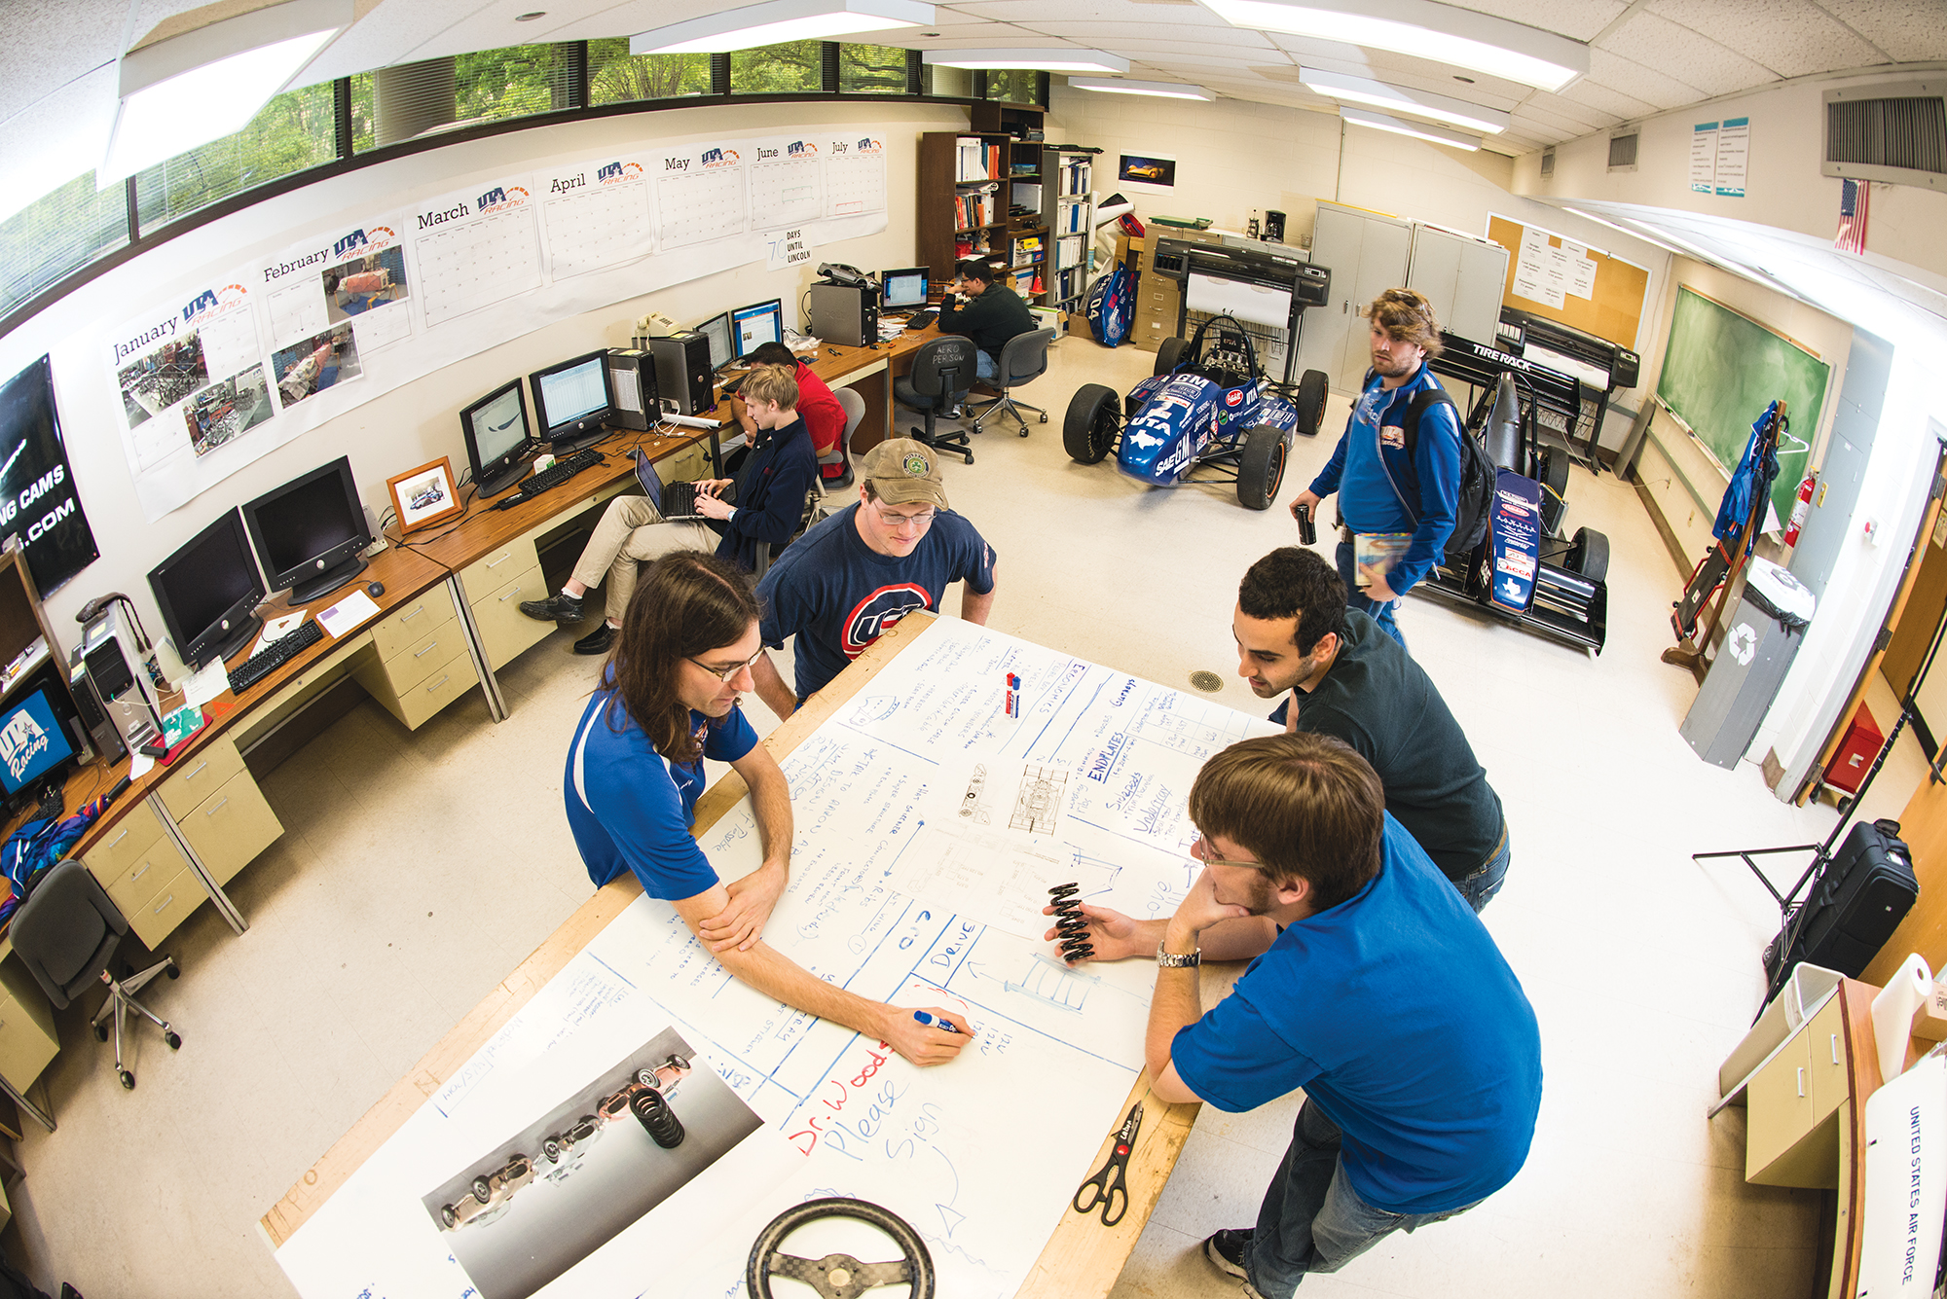
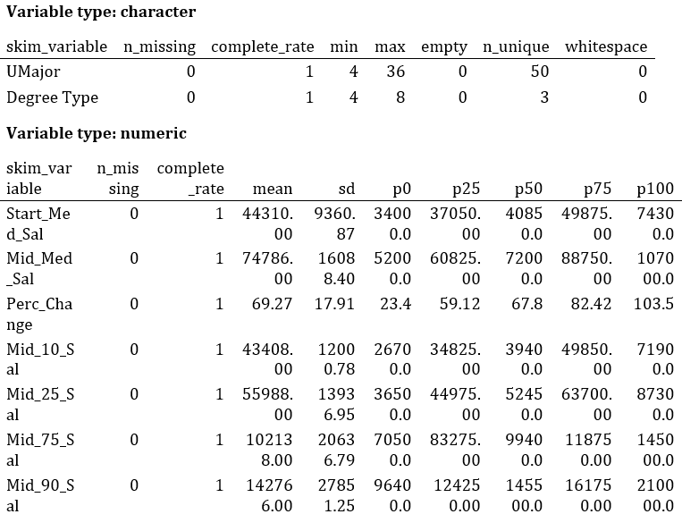
Exploration
First, we compute the summary statistics for our variables.
There are no NA values which is good

Slide 6

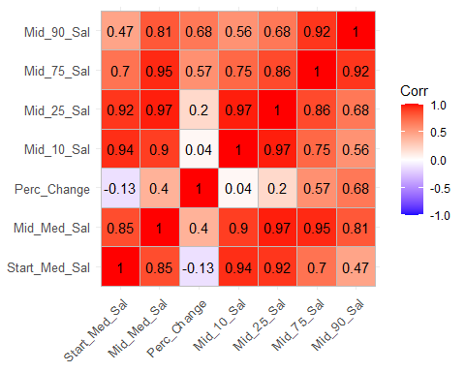
Exploration Cont.
Now, we plot our correlation matrix.
We can see that mid 10th percentile salary and mid 25th percentile salary both have a strong correlation to starting median salary.
Mid 25th percentile salary also has a high correlation to mid 10th percentile salary.
We decided to drop the mid 10th, 25th, and 75th salaries as they were strongly correlated with the other variables.

Slide 7

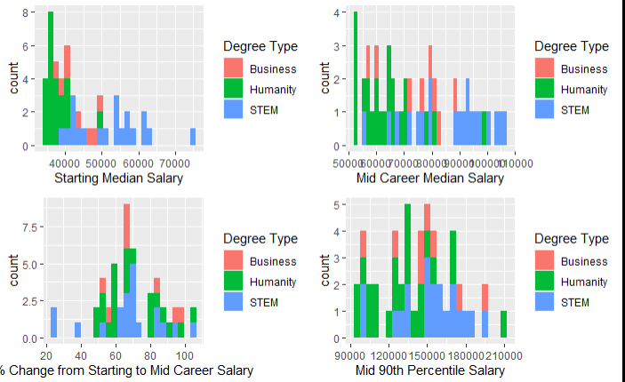
Exploration Cont.
To get a better feel of our data and see how it is distributed, we plotted the histograms shown to the right.
They are grouped by Business, Humanity, and STEM.
Here, there are some interesting results.

Slide 8

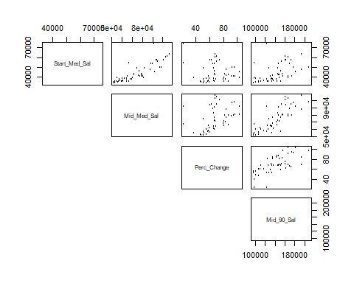
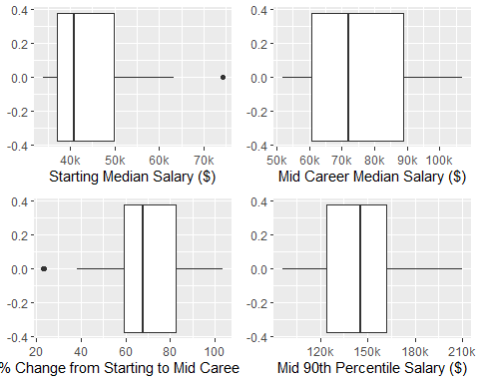
Exploration Cont.
Next, we created a scatterplot and boxplot of our variables. In the scatterplot, certain variables seem to have a positive correlation, such as starting median salary with mid-career median salary, and a somewhat positive correlation between mid 90th percentile salary with mid-career median salary and percent change.
The boxplots show that we have two outliers, one in starting median salary and one in percent change.

Slide 9

Exploration Cont.
Now that we have concluded our exploratory analysis, we will now move on to bootstrapping and will calculate the confidence intervals to answer the following questions.

Slide 10

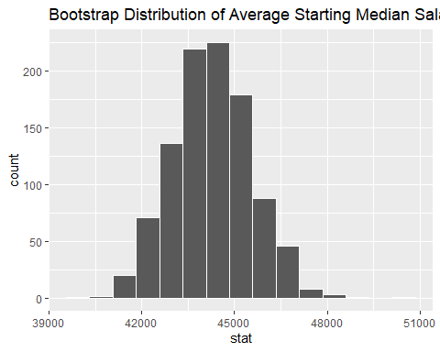
Bootstrapping: What is the average starting median salary for a degree?
Here, we visualize our results in a histogram.
The center of the histogram is around 44,000, so the average college graduate’s starting median salary is around $44,000 per year.

Slide 11

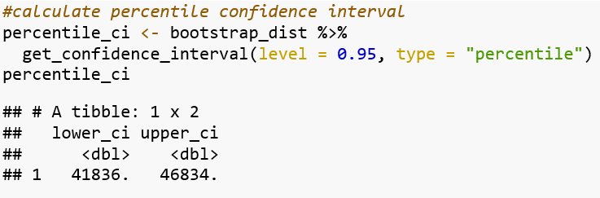
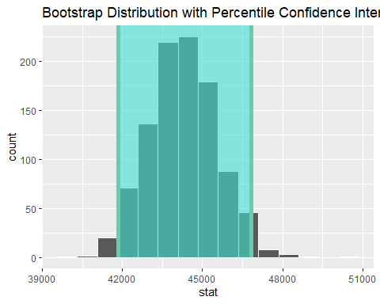
Percentile Confidence Interval
Now, we calculate the confidence interval using the percentile method. We can see that about 95% of the variable values fall between 41,836 and 46,834.
So, the lowest starting median salary is around $42,000, while the highest starting median salary is around $47,000.
Next, let’s check the confidence intervals with the standard error method.

Slide 12

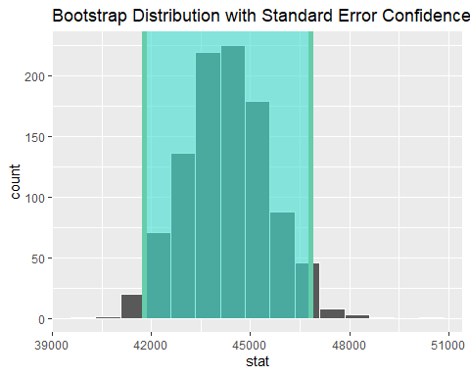
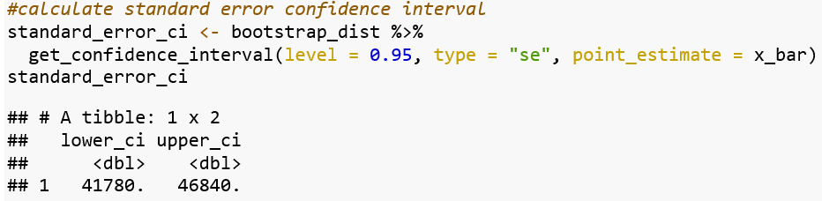
Standard Error Confidence Interval
We can see that about 95% of the variable values fall between 41,780 and 46,840. These are slightly different values from the ones calculated with the percentile method.
So, we can still conclude that college graduates start out with around $42,000 per year, while the highest paid college graduate makes around $47,000 per year.
Now, let’s explore our next question.

Slide 13
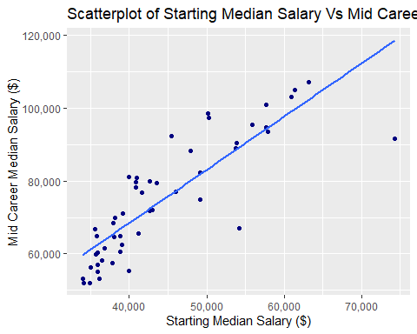
What is the relationship between starting median salary and mid-career median salary?
First, we created a scatterplot of starting median salary and mid-career median salary to see if there was a correlation between the two.
Clearly, we can see that there is a positive correlation between the two variables from the scatterplot.

Slide 14

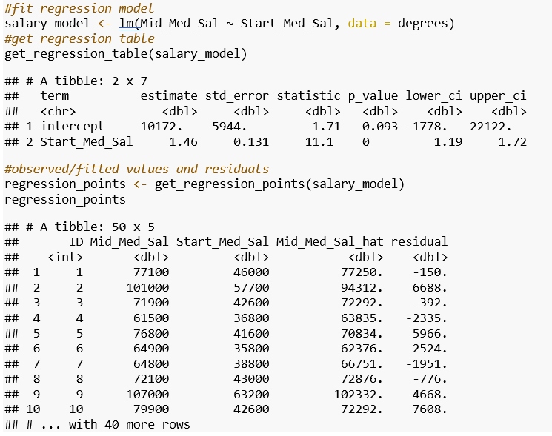
Linear Regression
Now, we will fit the model using linear regression.
For every 1 unit increase in Start_Med_Sal, there is an associated increase of 1.46 units of salary.
Our p-value is small, which means there is a significant positive relationship between starting median salary and mid-career median salary.

Slide 15
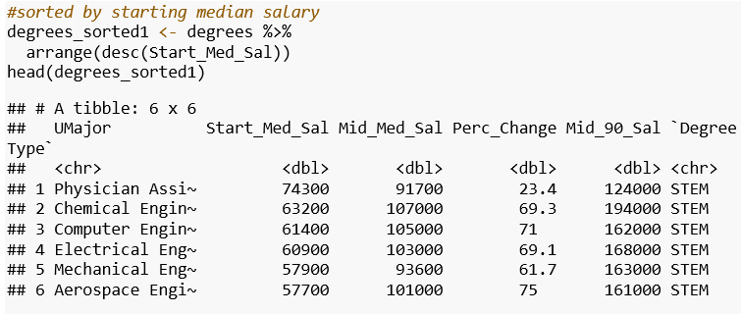
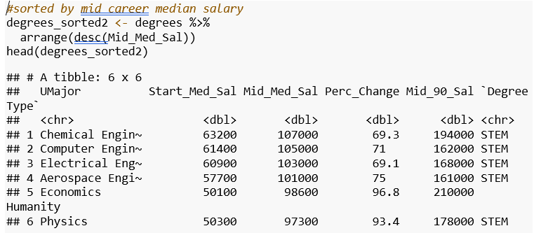
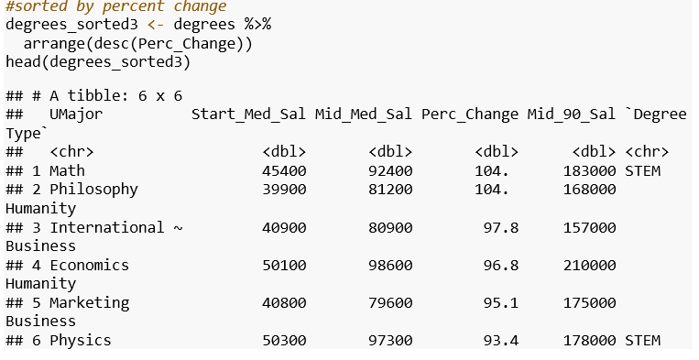
What degrees make the most money?
We sorted starting median salary, mid-career median salary, and percent change from highest to lowest.
For starting salary, we can see that physician assistant graduates make the most when they first start out.
However, engineering majors seem to dominate the charts in terms of the highest paid mid-career salary.
Lastly, math majors and philosophy majors show the highest potential for growth, as they scored top two in the percent change category.

Slide 16

Conclusion
Overall, we discovered the following:
The average starting median salary ranges from $42,000 to $47,000 per year.
If you want to make the most money when you are a fresh graduate, becoming a Physician’s Assistant is ideal; however, there is little potential for salary growth.
For a stable, generally well-paying job, a degree in engineering is the best way to go.
For a degree that has the highest growth potential, choose a math or philosophy major.

Slide 17

THANK YOU PROFESSOR LIAO AND CLASSMATES!!!

